Slide 1

http://php.net/

Slide 2
What is PHP?
PHP
Hypertext
Preprocessor
Allows web developers to create dynamic content that interacts with databases.

Slide 3
PHP
Development started in 1994,
by Rasmus Lerdorf.
PHP originally abbreviation for ‘Personal Home Pages’
Open Source
server-side Scripting
PHP code executes on Server.
HTML-embedded scripting language
Cross-platform
Simpler and faster to develop applications
PHP is compatible with almost all servers used today (Apache, IIS, etc.)
PHP Support Many Databases like (Mysql ,SQL Server ,Oracle)

Slide 4
Advantages of PHP
Light-weight
Cross-platform compatible
Procedural / Object Oriented programming
Supports wide range of Databases
Supports wide variety of outputs
Open source
Notes:
Protocols: LDAP, IMAP, SNMP, NNTP, POP3, HTTP, COM etc…

Slide 5
What We Need For PHP ?
PHP Software
A Web Server (Apache , IIS)
An RDBMS (DATABASE Software) (MYSQL)

Slide 6
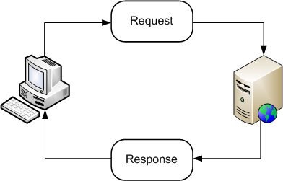
What is A Web Server ?
Web server Is an Application which Generate Responds upon client requests by providing resources.

Slide 7
APACHE
Apache is a Most Popular & Powerful Web Server.
It Provide Cross Platform Compatibility
Mostly PHP Developer Use Apace As a WEB SERVER

Slide 8
How To Install PHP ?
There Are Different Development Packages available for PHP.
Package:- collection Of Software's.
These Are Some Development Packages:
XAMPP Server
WAMP Server
LAMP Server
MAMP Server
SAMP Server

Slide 9
WEB DEVELOPMENT PACKAGES
XAMPP (X→ Cross Platform)
Provide APACHE , MYSQL , PHP , PERAL
WAMP (W→ Windows)
Provide APACHE , MYSQL , PHP
LAMP (L→ LINUX)
MAMP (M→ Macintosh)
SAMP (S→ Sun Solaris)

Slide 10
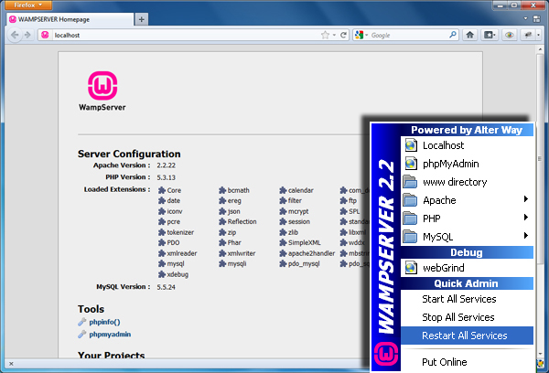
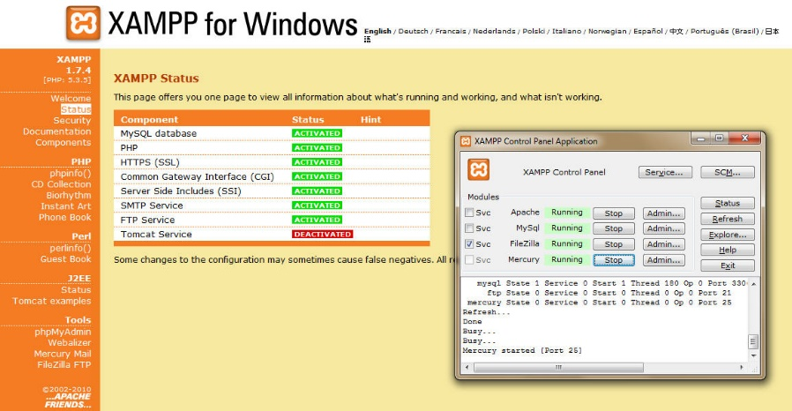
Web Server
XAMPP
https://www.apachefriends.org
WAMP
http://www.wampserver.com/en/

Slide 11
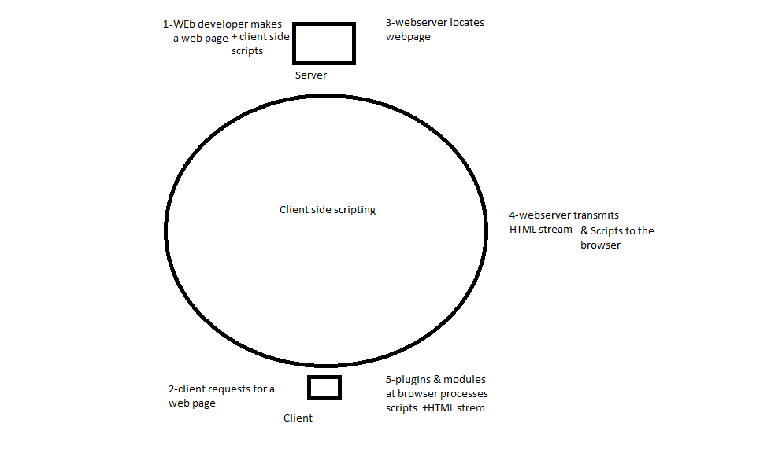

Slide 12
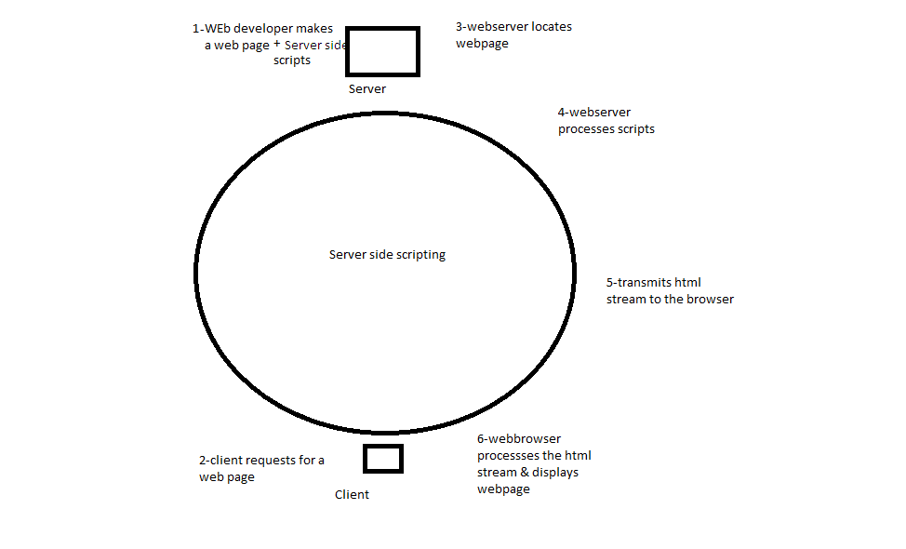

Slide 13
What is content management system?

